Slide 1
FOOD DELIVERY PLATFORM
Food Delivery Platform Analysis
Customer · Orders · Delivery · Restaurant Intelligence
By : Mahalakshmi
Mentor : Mrs. Priya Shanmugam
Batch : DA644S64 Course Name : Data Science & ML With Gen AI

Slide 2
Problem Statement
To understand customer preferences and demand patterns in order to design the right menu, optimize operations, and build a profitable restaurant.
1. Customer Profiling
2. Order & Revenue Analysis
3. Delivery Performance
Segment customers by age, gender, city type
cuisine preference.
Identify repeat vs. new customer patterns.
Compare delivery speed across regions and vehicle types.
Identify top partners with high ratings and low delays.
Uncover monthly order trends
payment preferences
festival-driven demand .
4. Restaurant Benchmarking
5. Machine Learning Models
6. Business Recommendations
Assess cuisine-wise demand
restaurant ratings to identify performance leaders.
Apply ML algorithms —Linear Regression , Logistic Regression, KNN, and K-Means
Translate data insights into strategic actions for improving retention, efficiency, and profitability.

Slide 3
DATA PREPROCESSING
Data Cleaning & Preprocessing Pipeline
Four datasets (Customer, Orders, Delivery Partner, Restaurant) were preprocessed in Jupyter Notebook then merged in Excel for unified analysis. Key pipeline steps:
🔗 Dataset Merge : Four CSVs joined on Order ID, Customer ID, Delivery Partner ID & Restaurant ID using Python— resulting in one flat table: 1,00,000 records x 33 columns
🗑️ Dropped Repeated & Unused Columns: Redundant post-merge ID columns and low-variance / duplicate feature columns removed to reduce noise before ML modelling
🏷️ Renamed Column Values: Category labels standardized(FESTIVAL/NON-FESTIVAL) for consistent grouping across all analysis steps
🧹 Imputing & Outlier Treatment: Missing values filled via median/mode; IQR-based capping on Dataset to remove extreme outliers before analysis
🔢 ML Preprocessing in Jupyter: Label encoding for categoricals; StandardScaler/MinMaxScaler applied per model; engineered features Value_per_Min, Rating_Diff, Discount_Ratio and Churn flag created
Tools: Python (pandas, scipy, sklearn) in Jupyter Notebook | Excel Power Query | Merged file: Food_delivery_dataset.xlsx

Slide 4
DATA OVERVIEW
Dataset at a Glance
22,000
100 K
1,100
551
Customers
Orders
Delivery Partners
Restaurants
₹592.22
35.5 min
4.02★
45.09%
Avg Order Value
Avg Delivery Time
Avg Order Rating
Repeat Customer Rate
Data : Customer.csv | Orders.csv (100K records, Jan 2023–Dec 2025) | Delivery_Partner.csv | Restaurant.csv

Slide 5
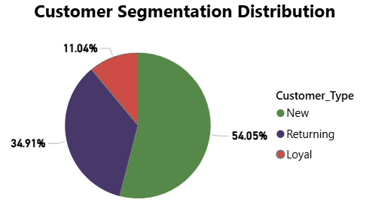
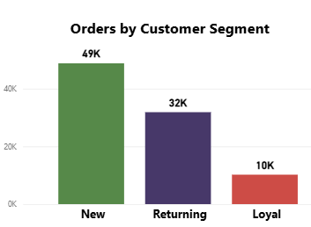
CUSTOMER ANALYSIS
Who Drives Revenue
New customers (~54%) place the highest number of orders (~49K), making them the main driver of total orders due to their large share.
Returning customers (~35%) contribute a strong number of orders (~32K), showing good repeat engagement and consistent activity.
Loyal customers (~11%) have the lowest orders (~10K), mainly because their segment size is small, not necessarily low engagement.
Notes:
Two-tailed Z test (checking whether rate is 45% or there is some difference. Null Hypothesis (H0): The true retention rate is equal to the hypothesized value. H0 :p=0.45933 Alternative Hypothesis (H₁): The true retention rate is different from the hypothesized value. H1 :p not equal to 0.45933 Significance Level: α = 0.05 Output: P-value = 1.0 This is the probability of observing the data assuming H₀ is true Z-statistic : Output: Z = 0.0 Meaning: Sample retention rate is exactly equal to the hypothesized value No deviation at all Statistical Decision : p-value (1.0) > α (0.05)
Fail to reject H₀

Slide 6
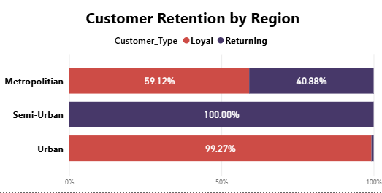
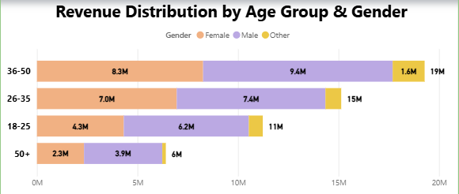
CUSTOMER ANALYSIS
Who Stays, Who Spends
Semi-Urban and Urban regions show the strongest customer retention, while Metropolitan regions display a more balanced mix of loyal and returning customers.
The 36–50 age group drives the highest revenue (₹19M), with males accounting for a larger share in the top two age bands.
Metropolitan cities show more Returning and loyal customer variety — a prime segment for targeted loyalty campaigns.
Notes:
Chi-square test of independence
Null Hypothesis (H₀): Spending category is independent of gender
Alternative Hypothesis (H₁): Spending category depends on gender
Significance Level (α): 0.05 P-value: 0.896
The p-value (0.896) is much greater than α (0.05) This indicates: The observed differences in spending categories across genders are not statistically significant
Since p-value > α : Fail to reject the null hypothesis (H₀)
There is no statistically significant relationship between: Gender Spending category

Slide 7
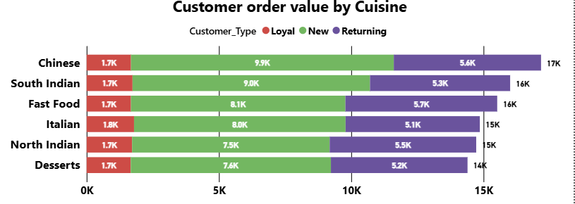
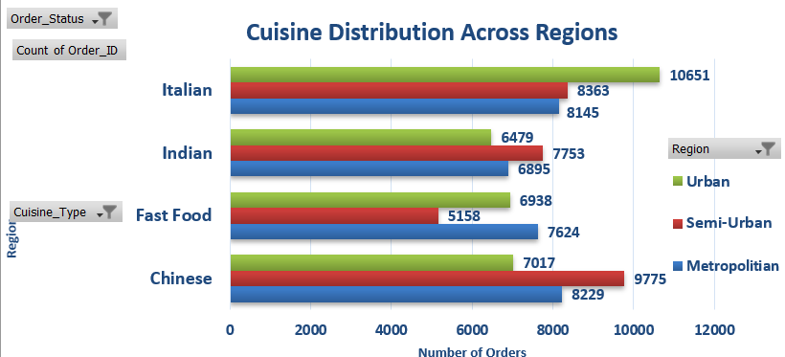
CUSTOMER ANALYSIS
Behavior explains how they order
New customers contribute the highest order value across all cuisines (around 8K–9.9K), while returning customers add steady value (around 5K–5.7K).
Chinese cuisine generates the highest total order value (~17K), followed by South Indian and Fast Food (~16K each), while desserts are lowest (~14K).
Cuisine preferences vary by region—Italian leads in urban areas (~10.6K orders), while Chinese is highest in semi-urban (~9.7K) and metro regions (~8.2K), showing clear regional demand differences.

Slide 8
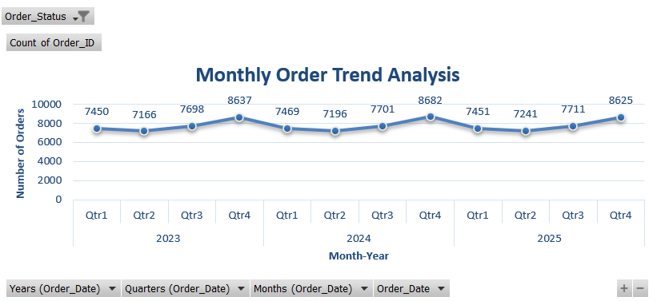
ORDER ANALYSIS
Monthly Order Volume by Region
orders peak in Q4 (~8637–8682 range) showing strong seasonal demand.
Q2 is consistently the lowest (~7166–7241 range), with a gradual rise toward year-end.

Slide 9
ORDER ANALYSIS
Order Status & Payment Mode Distribution
💡 93% delivery success rate. UPI dominates at 50% — digital payments are the clear preference. Cash usage at 10% is declining, aligning with India's digital payment revolution.

Slide 10
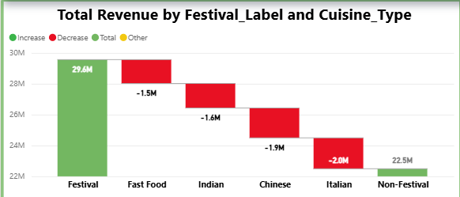
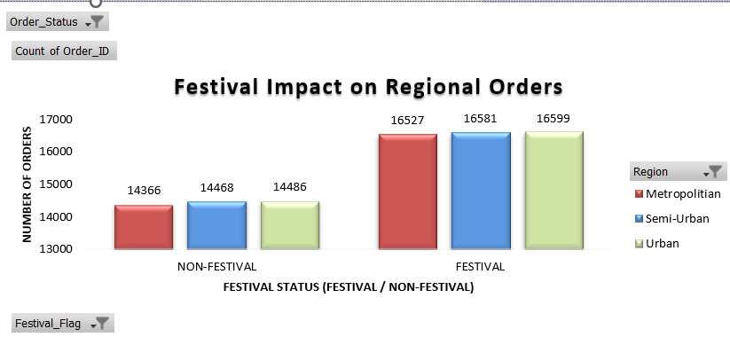
CUSTOMER ANALYSIS
Festivals Fuel the Platform
Festivals are the top revenue driver: ₹29.6M vs ₹22.5M (non-festival) with 14–17% higher order volume
Focus on premium bundles & targeted offers during festivals to maximize revenue.
Notes:
Two-sample t-test
Null Hypothesis (H₀): Average order value is the same in both cases
Alternative Hypothesis (H₁): Average order value is different
Test Output t-statistic = 73.95 p-value = 0.0
Huge t-statistic (~74) The difference between groups is extremely large relative to variability
p-value ≈ 0 → Probability of seeing this difference by chance is virtually zero Decision (α = 0.05): p-value < α : Reject H₀
p-value ≈ 0 : There is a statistically significant difference in order value between festival and non-festival periods

Slide 11
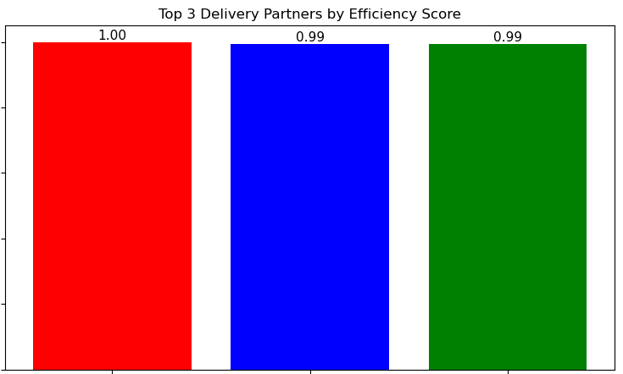
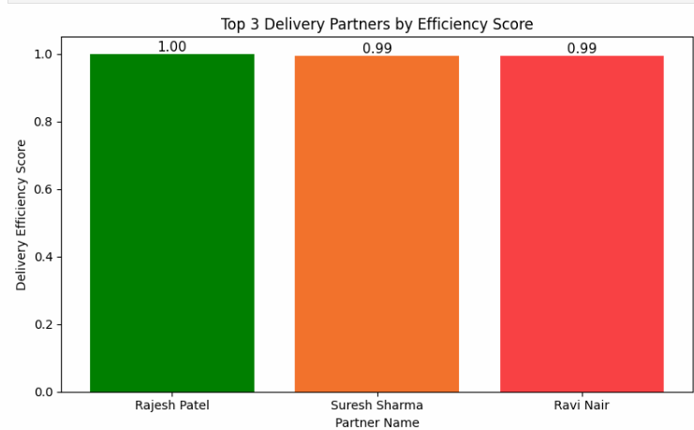
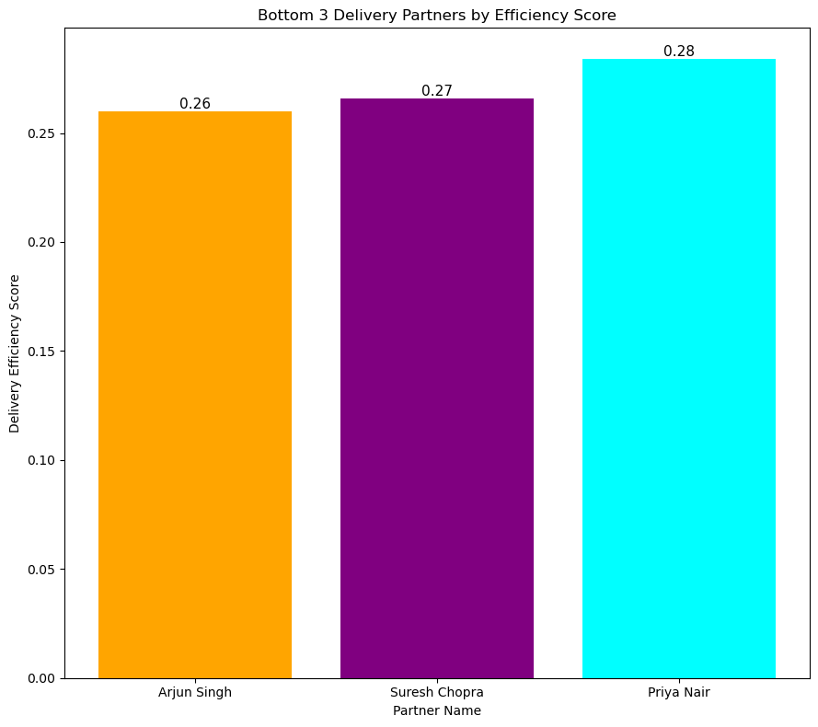
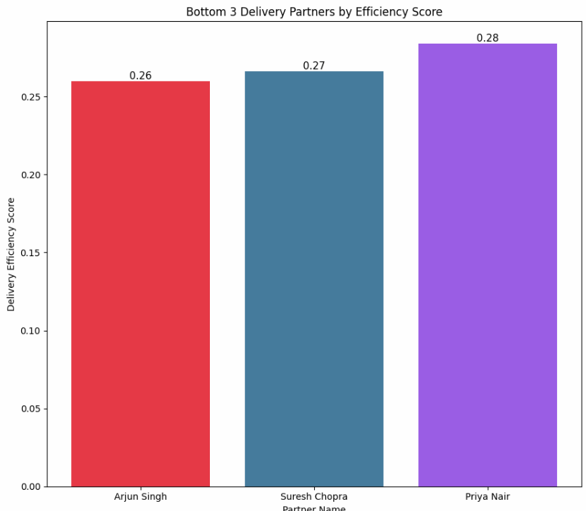
DELIVERY
Delivery Speed: Region vs Vehicle Type
Does where you deliver matter more than what you ride?
5.0★
23 kmph
16 kmph
Urban speed(fastest region)
Semi-Urban speed (slowest region)
Top partner rating
Region is the #1 speed driver — Urban is 30% faster than Semi-Urban. Vehicle type barely matters — Scooter vs Bike gap is under 1 kmph.) — invest in route optimisation for Semi-Urban speed, not vehicle upgrades.

Slide 12
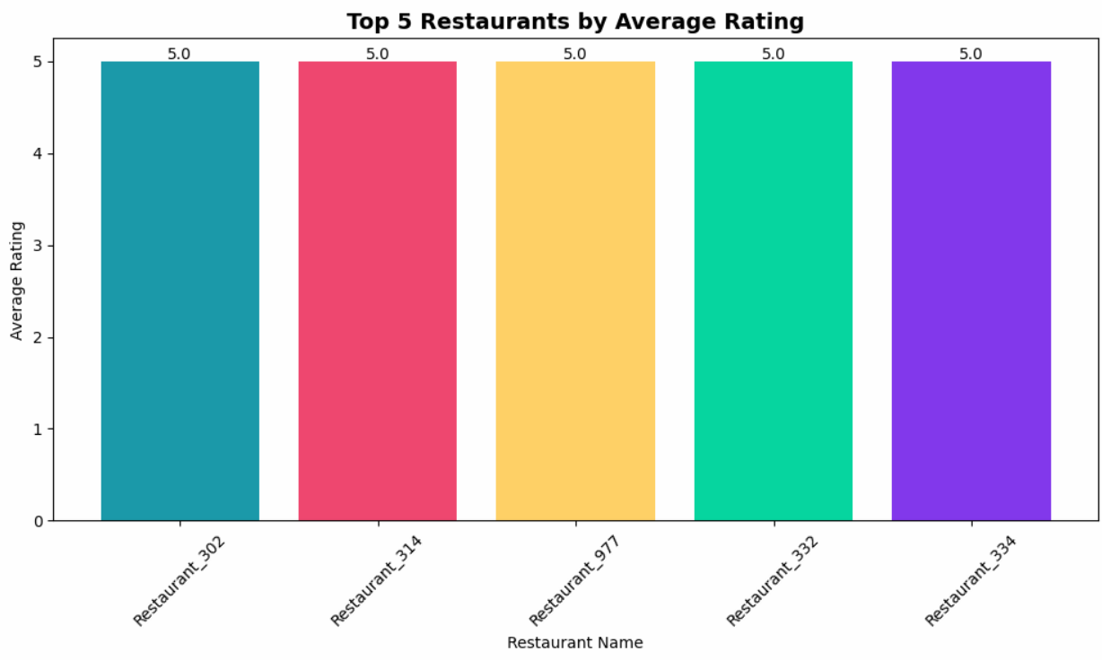
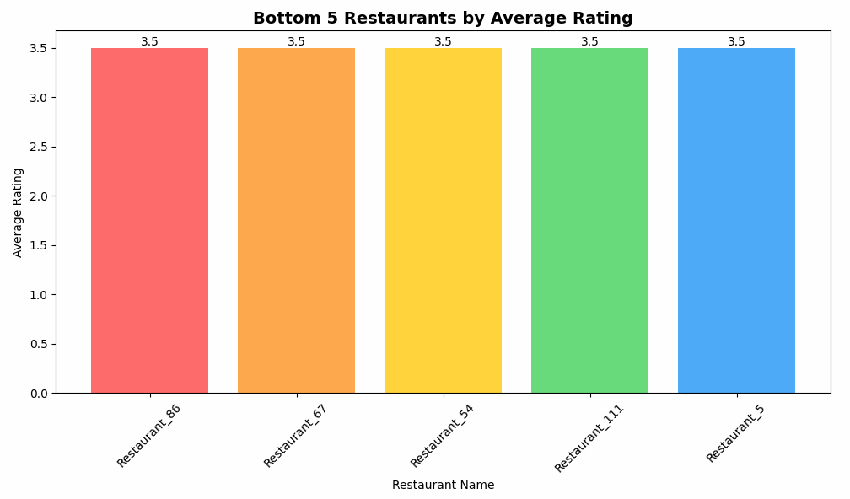
RESTAURANT ANALYSIS
Top 5 & Bottom 5 Restaurants by Rating
Which restaurants lead — and which need the most improvement?
TOP 5 RESTAURANTS
BOTTOM 5 RESTAURANTS
KEY INSIGHTS Top 5 restaurants all score a perfect 5.0★ — premium quality ceiling. Bottom 5 all score 3.5★ — a 1.5★ gap highlights a significant quality divide across the network.
SUGGESTION: Enrol bottom 5 restaurants in a quality improvement programme — target 4.0★ minimum. CONCLUSION: Huge rating spread signals uneven partner quality. FUTURE: Introduce a tiered partner rating system to incentivise consistent performance.

Slide 13
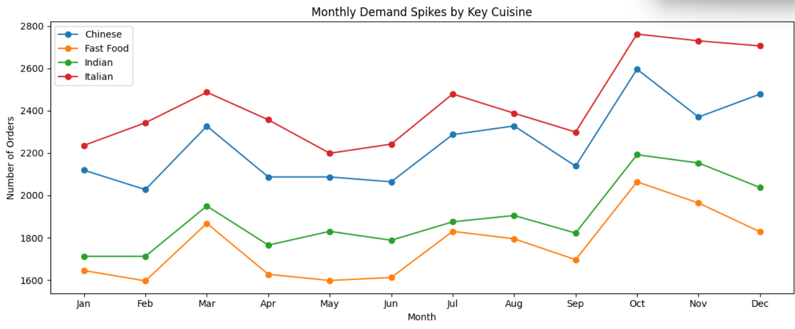
RESTAURANT
Seasonal Demand by Cuisine
Monthly order volumes reveal when each cuisine peaks across the year
Chinese
Oct–Nov
Fast Food
Highest volume
cuisine year-round
Peak demand
months
Most stable &
lowest volume
Mar spike

Slide 14
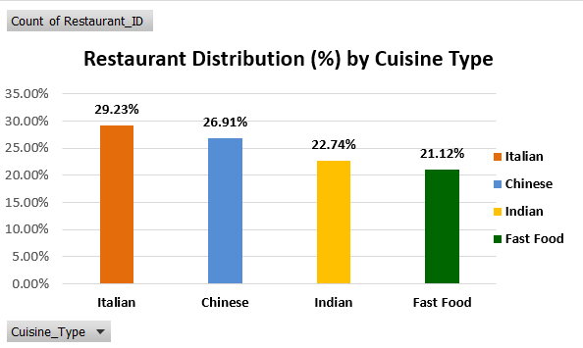
RESTAURANT ANALYSIS
Restaurant Performance by Cuisine
4.62★
Avg Restaurant Rating
26.9 min
Avg Preparation Time
4.02★
Avg Customer Order Rating
💡 Italian cuisine has the most restaurants (29.23%), followed by Chinese (26%). Restaurants maintain excellent internal ratings (4.62★) but customer order ratings are modest (4.02★), pointing to delivery experience gaps.

Slide 15
HYPOTHESIS TESTING & PROBABILITY RESULTS
Test 1 | One-Sample Z-Test
Test 2 | Two-Sample T + Paired T
Test 3 | Chi-Square Independence
Test 4 | Chi-Sq GoF + Homogeneity
📊 Statistical Insights
📊 Statistical Insights
📊 Statistical Insights
📊 Statistical Insights
Z-stat: −31.81
2-Sample t: 73.15
χ² stat: 2.88
GoF χ²: 68,262
Sample: n = 1,00,000
Paired t: −23.37
df: 6
Homog χ²: 3.33
p-value: p < 0.0001
p-value: p < 0.0001 (both)
p-value: p = 0.8241
GoF p-val: p < 0.0001 → REJECT ✓
Decision: REJECT H0 ✓
2-Sample: REJECT H0 ✓
Decision: FAIL TO REJECT H0
Homog p: p = 0.9121 → Fail to Reject
Mean delivery: 35.51 min
Paired: Fail to Reject
Cramer's V: 0.004 (negligible)
4–5 star: 78% of orders
P(< 30 min): 13.13%
Festival avg: Rs. 581
Conclusion: Payment & Customer Type independent
1–2 star: 7% equally across regions
P(> 40 min): 18.02%
P(fest > non): 67.95%
💼 Business Insights
💼 Business Insights
💼 Business Insights
💼 Business Insights
Mean delivery FASTER than benchmark — promote as competitive USP
Festival orders avg Rs.581 vs Rs.505 — activate premium bundles 3 days pre-festival
Payment mode is independent of customer loyalty — no need for tier personalisation
Ratings skew 4–5 stars (78%) — leverage in ads: '4 in 5 rate us 4+ stars'
18% exceed 40 min — deploy real-time routing to cap late deliveries
Enable surge pricing during high-demand festival windows
Launch a single UPI cashback campaign (e.g., 5% back) for ALL user segments
7% low-star orders are a UNIVERSAL failure — not regional; audit everywhere
SLA partner incentives: bonus for <35 min, penalty for >42 min
Paired test: discounts drive upsell — use as entry point, upsell add-ons
Redirect loyalty-tier budget toward cuisine personalisation & speed guarantees
Deploy auto-recovery: trigger compensatory voucher for any rating below 3 stars
Auto delay alerts + free vouchers for orders running >40 min
Automate festival campaign calendar linked to Indian public holiday schedule
Simplify checkout — removing payment-tier segmentation reduces friction
Run monthly root-cause analysis on 1-star orders: packaging, partner, or restaurant?

Slide 16
Automating Food Delivery Operations with SQL
MySQL
TRIGGERS
EVENTS
BEFORE INSERT
ON: orders
EVERY 1 MONTH
STARTS: 2025-02-01
Apply Discounts Before Order Creation
Festival order → 10% discount on order_value
UPI payment → 5% discount (stackable)
Sets discount & final_amount before row insert
Logs: order value, discount, final, mode, festival flag
Generate Monthly Revenue Summary
Aggregates last month's delivered orders
Logs total orders, total revenue
Splits revenue: Festival vs Non-Festival
AFTER INSERT
ON: orders
Update Customer Status After Order Placement
Increments total_orders; recalculates average_spend
Promotes customer_type: New → Returning → Loyal
(thresholds: ≥3 orders → Returning, ≥10 → Loyal)
Logs: customer_id, order_id, final_amount
EVERY 1 WEEK
STARTS: CURRENT_TIMESTAMP
Identify Delayed Delivery Partners
Scans all delivery partners (total deliveries > 0)
Flags partners with delayed count / total > 20%
Logs each offender + summary count to activity log
AFTER UPDATE
ON: orders
Update Delivery & Restaurant Performance
Fires only when status changes → 'Delivered'
Restaurant: total_orders++, recalc avg_rating
Partner: total_deliveries++; delayed++ if >45 min
Logs: order_id, rating, delivery_time
BEFORE INSERT — pre-row logic
AFTER INSERT — post-insert logic
AFTER UPDATE — on status change
Event Scheduler ON required

Slide 17
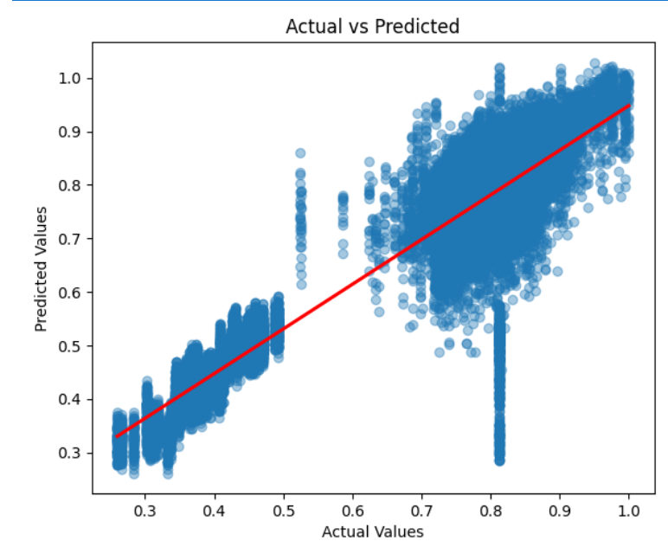
LINEAR
REGRESSION
ACTUAL VS PREDICTED PLOT
TARGET
Delivery_Efficiency_Score
INPUT FEATURES
Avg_Prep_Time_Mins
Average_Spend
Avg_Delivery_Speed
MODEL METRICS
Successful_Deliveries
R² Score
MSE
RMSE
MAE
Total_Orders
0.8347
0.0071
0.0841
0.0579
Order_Capacity_Day
83% variance explained
Mean squared error
Root mean sq. error
Mean absolute error
💡 Strong R² of 0.83 shows the model explains most variation in delivery efficiency; low MAE of 0.058 confirms predictions are reliably close to actual scores.
Algorithm: Ordinary Least Squares | Scaler: StandardScaler | Split: 80/20

Slide 18
LOGISTIC
REGRESSION
MODEL PERFORMANCE (Binary Classification · No Visuals)
Accuracy
F1 Score
TARGET
88.26%
0.8324
Churn (0=Retained · 1=Churned)
Correct predictions overall
Harmonic mean of Precision & Recall
INPUT FEATURES
Precision
Recall
93.69%
74.89%
Order_Value
Order_Rating
Delivery_Time_Mins
Of predicted churned → truly churned
Of actual churned → correctly caught
Avg_Customer_Rating
Discount_Applied
Dataset Distribution:
Final_Amount
Retained (0): 60,801 · Churned (1): 39,199 · Total: 1,00,000 orders
Delivery_Eff_Score
Value_per_Min
Rating_Diff
Discount_Ratio
💡 Accuracy of 88% with Precision of 94% means almost no false churn alerts; Recall of 75% indicates 1 in 4 churners may be missed — trade-off to monitor.
Algorithm: LogisticRegression (max_iter=1000) | Scaler: StandardScaler | Split: 80/20

Slide 19
KNN
CLASSIFIER
MODEL PERFORMANCE (Multi-class · No Visuals · Best K = 20)
Accuracy
F1 Score
TARGET
92.97%
0.9199
Customer_Type (Multi-class)
New
Highest among classifiers
Macro average across classes
Returning
Loyal
Precision
Recall
INPUT FEATURES
92.35%
91.64%
Order_Value
Final_Amount
Average_Spend
Macro average
Macro average
Delivery_Time_Mins
Delivery_Eff_Score
Avg_Delivery_Speed
Optimal K Selection:
Delayed_Deliveries
K tested from 1 → 20 · Best K = 20 · Stratified 80/20 split used to preserve class balance
Order_Rating
Avg_Customer_Rating
Total_Orders
Cuisine_Type
Preferred_Cuisine
💡 KNN achieves the highest accuracy (93%) across all three customer types, showing spending and delivery behaviour are strong signals for customer segmentation.
Age_Group
Algorithm: KNeighborsClassifier | Scaler: MinMaxScaler | Split: 80/20 (stratified)

Slide 20
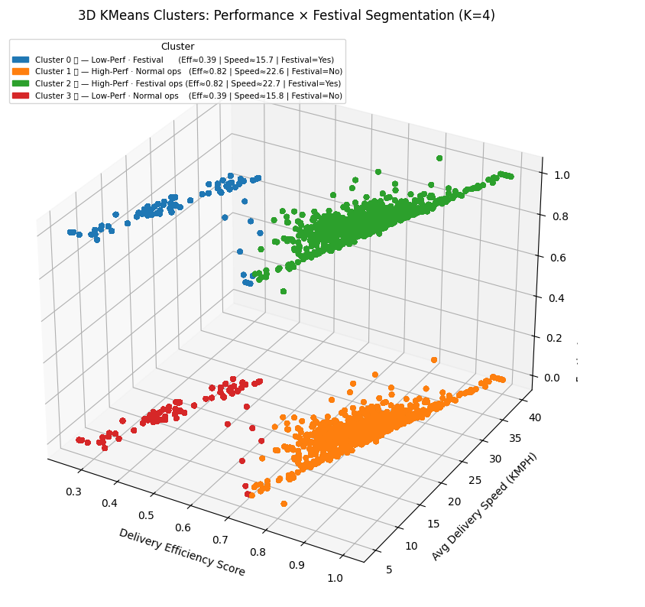
K
K-Means Clustering
OPTIMAL K
RECORDS
SILHOUETTE
4
100,000
0.6574
Food Delivery · Courier & Restaurant Segmentation
INPUT FEATURES
3D CLUSTER VISUALIZATION
OUTPUT CLUSTERS
Delivery Efficiency Score × Avg Speed (KMPH) × Festival Flag
Efficiency Score
K = 4 · 100,000 delivery records segmented
Composite courier performance index
0
Low-Perf · Festival ops
Avg Speed (KMPH)
Low Efficiency
10–20 KMPH
Average km/h per completed order
Festival = Yes
Underperformers during festival periods. Require retraining or redeployment.
Festival Flag
Binary: 1 = festival, 0 = regular
1
High-Perf · Normal ops
EVALUATION · K = 4
High Efficiency
20–30 KMPH
0.6574
Silhouette Score
↑ higher is better
Festival = No
Top performers in regular operations. Deploy on high-value routes.
27,350
Calinski-Harabasz
2
High-Perf · Festival ops
↑ higher is better
High Efficiency
20–30 KMPH
0.5521
Davies-Bouldin
Festival = Yes
Elite performers maintaining quality during peak festival demand. ★
↓ lower is better
3
Low-Perf · Normal ops
Low Efficiency
10–20 KMPH
Festival = No
Chronic underperformers in regular operations. Priority for coaching.
Cl 0 — Low-Perf · Festival ops
Cl 1 — High-Perf · Normal ops
Cl 2 — High-Perf · Festival ops
Cl 3 — Low-Perf · Normal ops

Slide 21
FINDINGS
Key Findings & Interpretations
👤 Customer Retention
📅 Seasonal Demand
Retention rate is only 46%. Italian cuisine shows highest loyalty. All age groups have similar avg spend, showing broad appeal.
Q4 is the peak period. Festival seasons drive 14–17% higher order volumes and elevated order values across all regions.
🍴 Restaurant vs Order Gap
🚴 Delivery Efficiency Gap
Restaurants rate 4.62★ internally but receive 4.02★ from customers. The 0.6-star gap likely reflects last-mile delivery experience issues.
Semi-Urban regions lag significantly at 16 KMPH vs Urban 23 KMPH. Vehicle type has no meaningful impact on delivery speed.
💳 Payment Mode Dominance
📦 Order Fulfilment
UPI leads with 50% usage, indicating a strong preference for fast, digital payments, while Cash (10%) is least preferred, showing a clear shift away from traditional methods.
93% delivery success rate is strong. 5% cancellation and 2% returns present revenue leakage that needs targeted intervention.

Slide 22
BUSINESS SUGGESTIONS
Strategic Recommendations
01
Loyalty Programme for South Indian Cuisine
02
Festival Campaign Planning
Dessert has the lowest repeat rate. Launch cuisine-specific loyalty rewards to close the gap with Italian.
Pre-load inventory and boost delivery partner availability in Q4. Create targeted festival bundles to capitalise on higher order values.
03
Semi-Urban Delivery Optimisation
04
Customer Experience Gap – Last Mile
Speed in Semi-Urban is lower than Urban. Invest in route optimisation software and partner incentives for these zones.
Address the 0.6★ gap between restaurant and order ratings. Improve real-time tracking, packaging, and handover quality standards.
05
UPI-First Payment Incentives
06
Cancellation Reduction Strategy
Reinforce digital adoption — offer cashback/discounts on UPI transactions to reduce expensive cash handling operations.
5% cancellation rate = revenue leakage. Introduce order confirmation nudges, smarter ETAs, and penalty-free modification windows.

Slide 23
OVERALL CONCLUSION
What This Means for the Business
Business Impact
This platform is sitting on a strong foundation — 1 lakh orders, 93% delivery success, and customers who actively come back. The biggest revenue opportunity is already identified: Q4 festival seasons when customers spend 15% more. The next step is to make sure the platform is fully prepared to capture that demand — with stocked inventory, enough delivery partners, and targeted offers.
The three areas that need immediate attention are: (1) converting new customers into repeat buyers through loyalty programmes, (2) improving delivery speed in Semi-Urban zones to match Urban performance, and (3) closing the gap between restaurant quality and customer delivery experience. These three actions alone can significantly boost revenue, retention, and customer satisfaction.

Slide 24
Thank You

